Slide 1
Classification of Immunity Booster Medicinal Plants Using CNN: A Deep Learning Approach

Slide 2
Architecture used in the Paper: we use convolutional neural network (CNN) for plant detection.
Dataset details:
Name: A Database of Leaf Images: Practice towards Plant Conservation with Plant Pathology
Link : https://data.mendeley.com/datasets/hb74ynkjcn/5
Published: 19 January 2022|Version 5
Contributors: Siddharth Singh Chouhan , Ajay Kaul , UDAY PRATAP SINGH , UDAY PRATAP SINGH
Description: Principally, the complete set of images have been classified among two classes i.e., healthy and diseased. First, the acquired images are classified and labeled conferring to the plants.

Slide 3
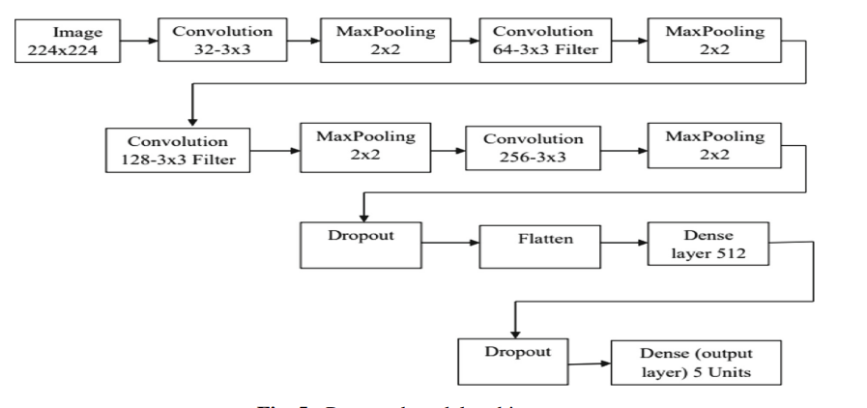
Implementation Details :
We used 12 layered network
We utilized an optimizer known as Adam optimizer
For 15 epochs of 35 batch
at that point begin our model utilizing the fit () strategy
Validation split is 0.2
Activation is ReLU rate is 0.25 and 0.5
Learning rate is 0.0003

Slide 4
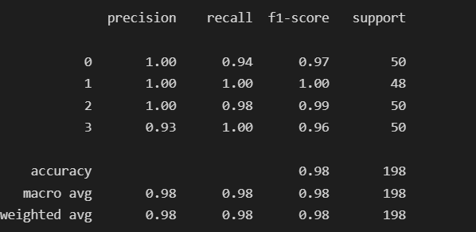
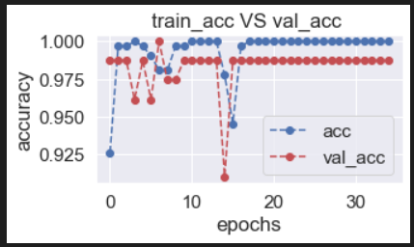
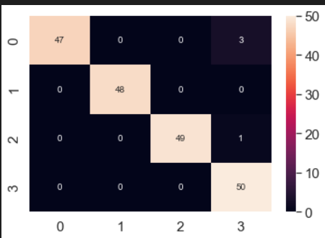
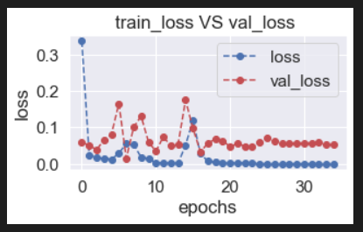
Results and visualizations:

